Slide 1
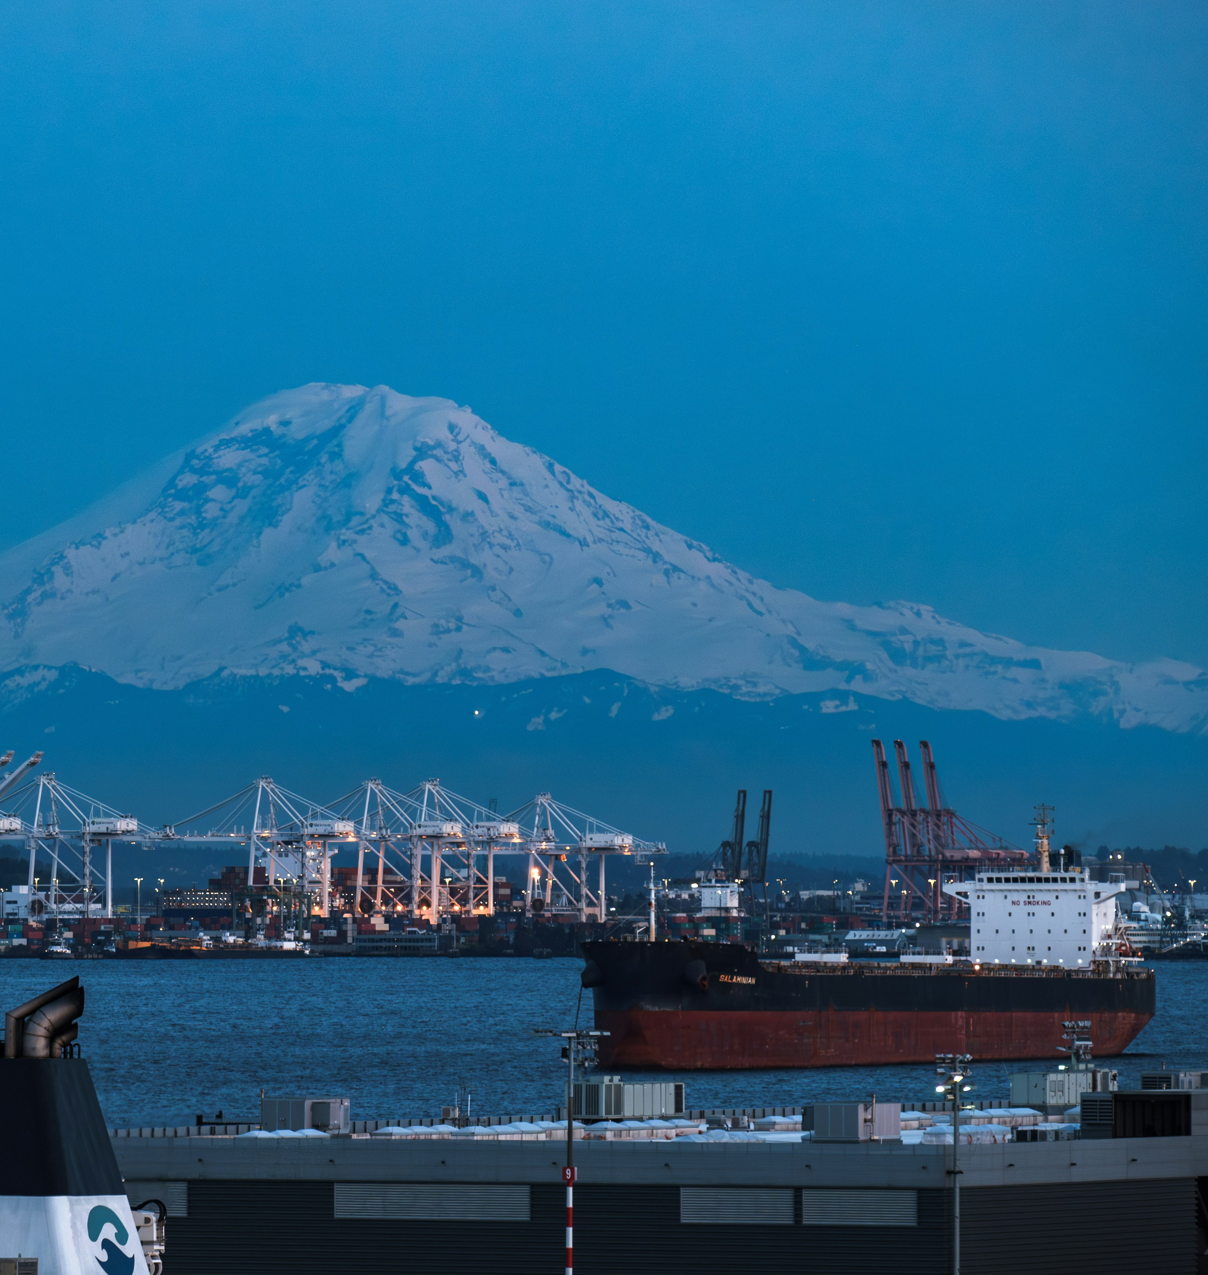
Port Performance In the Pacific Northwest Insights for the Maritime Freight Economy
Adam Wilson
Jake Wagner
Hanouf Alhunayshil
Notes:
This research was supported by the U.S. Department of Agriculture, Agricultural Marketing Service. The findings and conclusions in this publication are those of the authors and should not be construed to represent any official USDA or U.S. Government determination or policy.
High fixed costs, low marginal costs, and economies of scale strongly incentivize capacity maximization in maritime freight.
This has resulted in cargo sharing between carriers since the days of sailing ships and is still the case in the modern maritime economy,
now in the form of Alliances – global agreements between carriers agreeing to share cargo and co-operate vessels.

Slide 2
Port Performance - Project Overview
Up-to-date database and analytical platform for principal US ports
Dock-level (800+ docks at 70 coastal ports)
Within-port and cross-port comparative analyses
Existing Resources are:
Outdated and/or too aggregated
Paywalled
Key Products:
Dashboard
Static Reports
Curated data

Slide 3
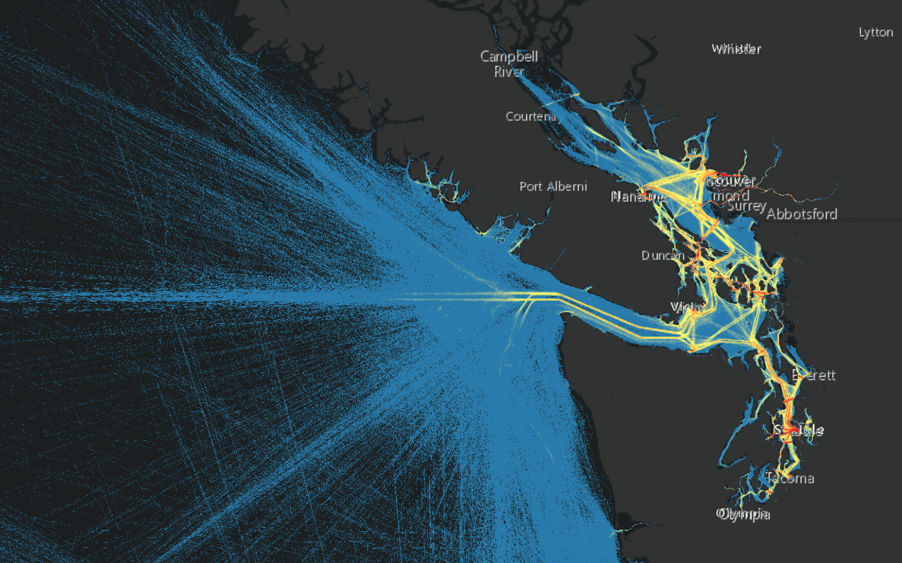
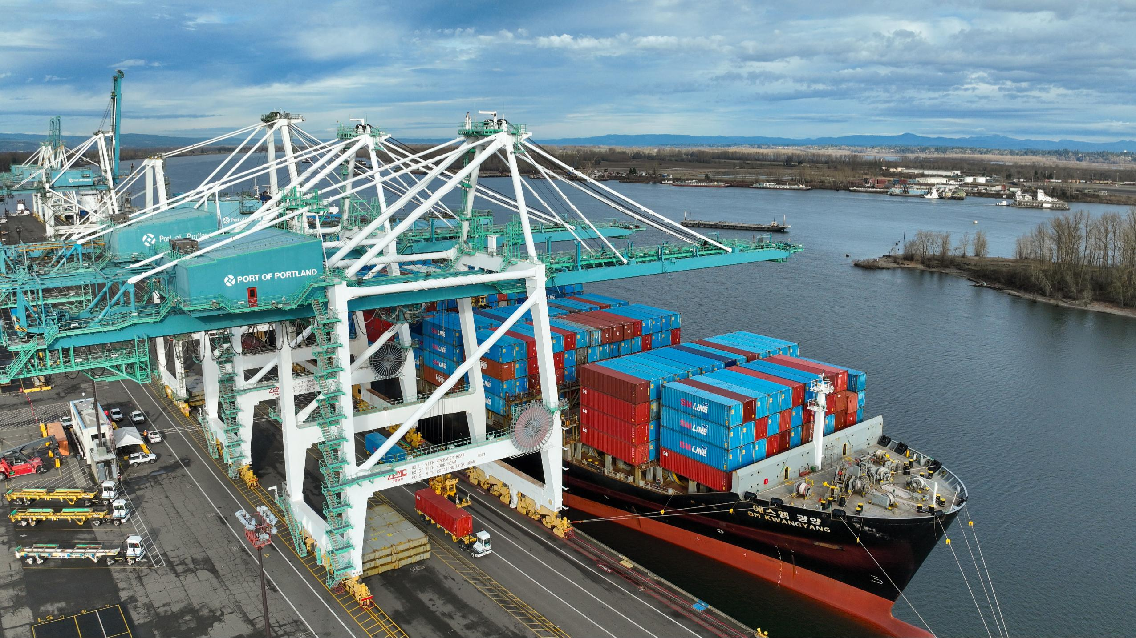
Key Data Sources
Automatic Identification System
Vessel location, identification, speed and course, status (docked, underway, anchored)
All commercial vessels, typically every minute (>2.5B obs)
Port and Dock Infrastructure
Dock purpose, number of cranes, rail access (number of tracks and service provider)
Semi-structured
Volume Data
US Census / Customs
Optional Proprietary Data (PIERS)

Slide 4
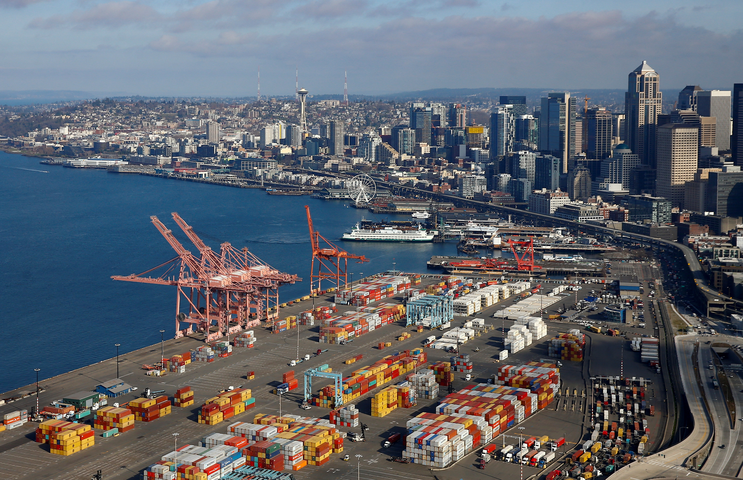
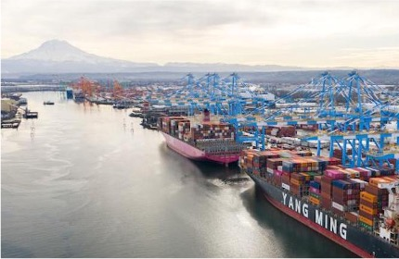
Northwest Seaport Alliance
Marine cargo operating partnership of the Port of Seattle and Port of Tacoma
Primary gateway to PNW
6th busiest container port in US
Recognized as the top-performing West Coast port by Logistics Management in 2024

Slide 5
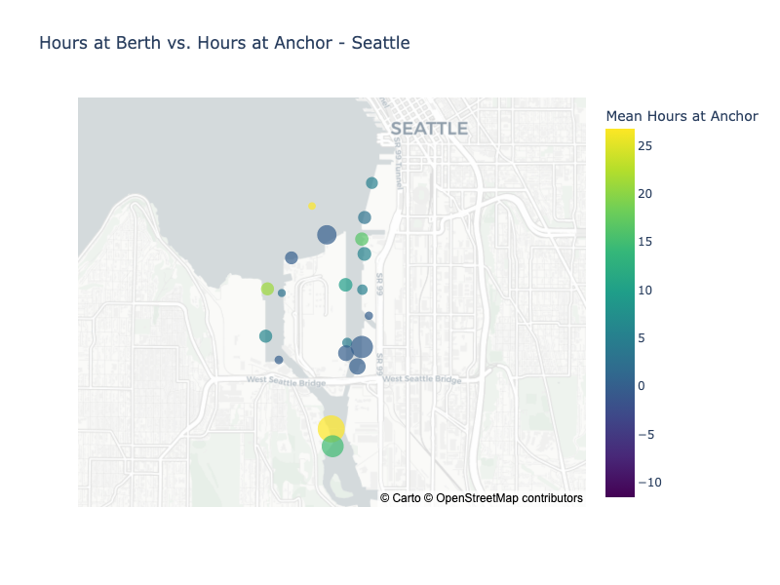
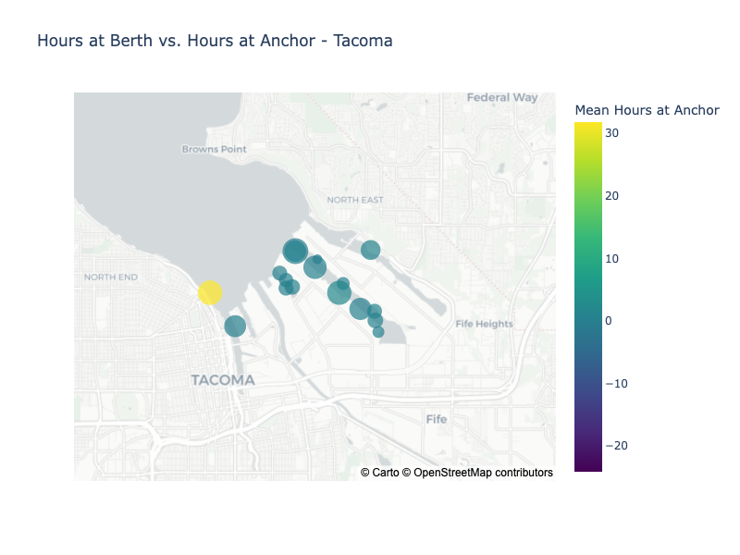
Northwest Seaport Alliance

Slide 6
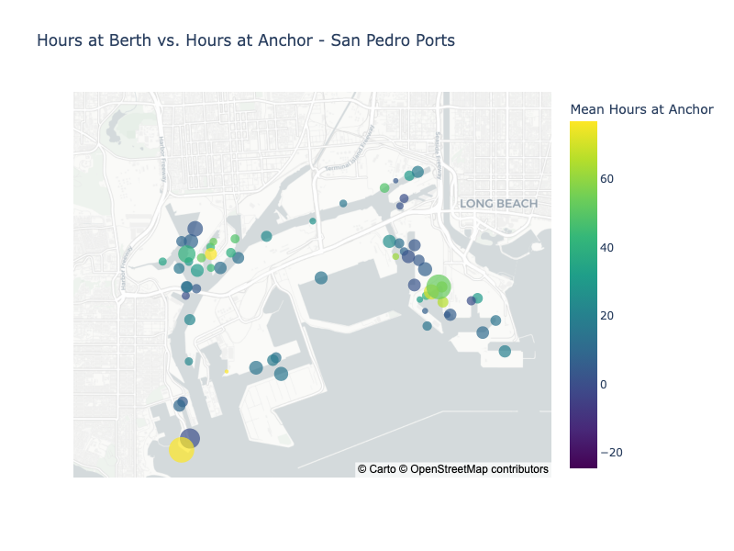

Slide 7
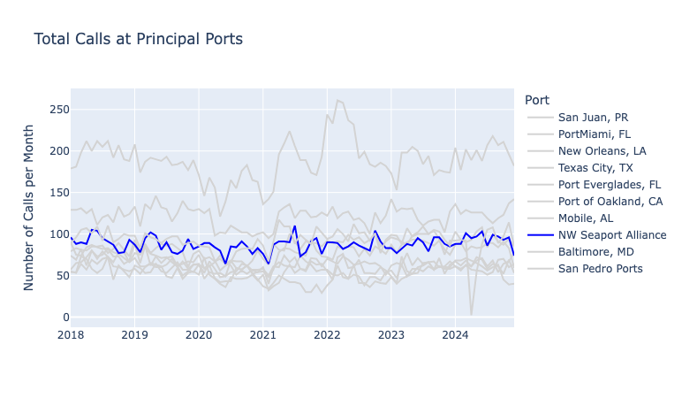

Slide 8
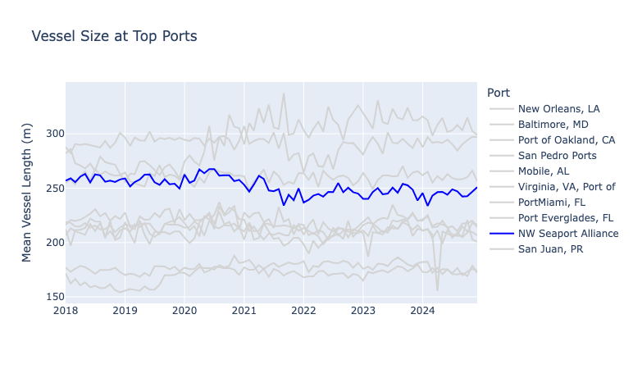

Slide 9
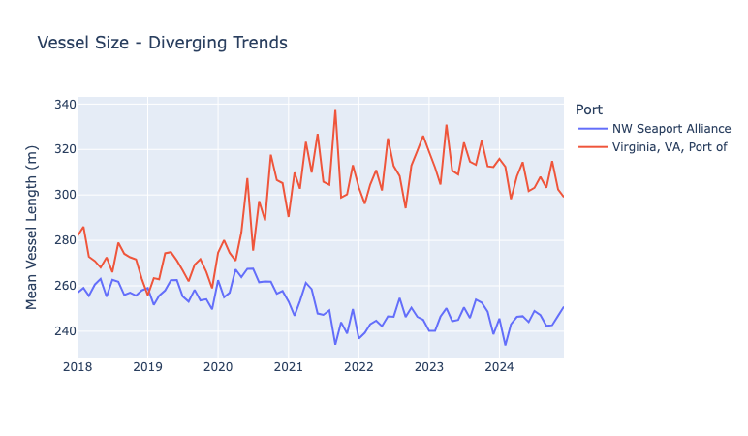
Notes:
This doesn’t account for changes in trade (e.g., more small vessels carrying cargos between PNW and Alaska)

Slide 10
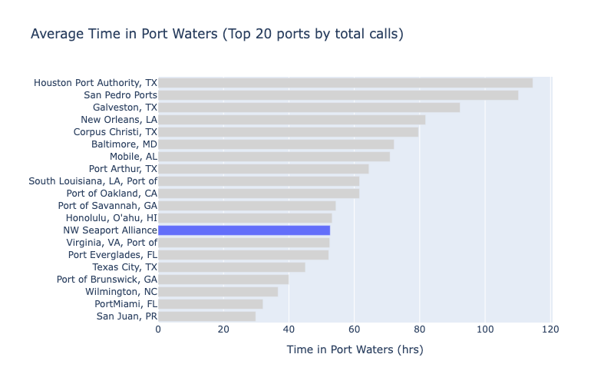

Slide 11
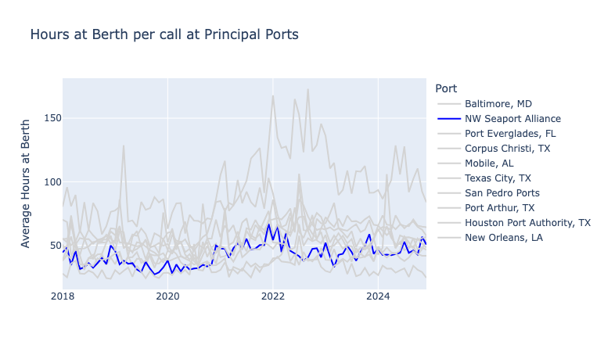

Slide 12
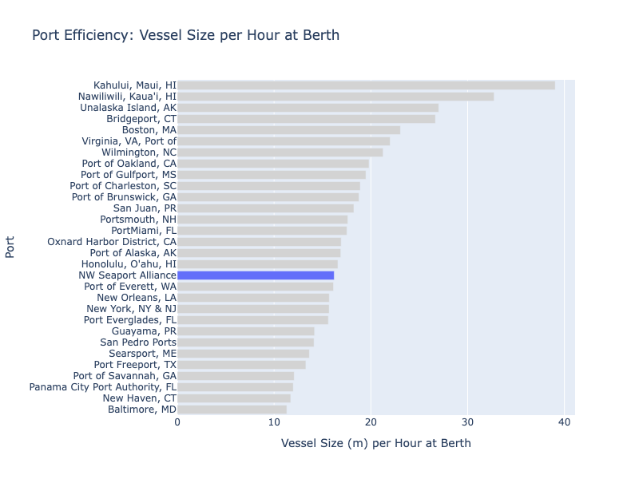

Slide 13
Dashboard Demo

Slide 14
Stakeholder Benefits & Next Steps
Port Authorities
Performance benchmarking and tracking over time
Identification of effective bottlenecks
State and Municipal DOTs
Infrastructure investment planning
ROI tracking
Researchers
Access to granular, up-to-date, tidy data
Next Steps:
Real-time AIS data
Historical infrastructure data
Integration with dock-level volumes
Breakouts by Commodity Types
Incorporate financial data (port fees per terminal, etc)
Potential Future:
Freight/Inland data integration

Slide 15

WSU’s School of Economic Sciences
Data-focused economists and transportation professionals with expertise in:
Research
Planning
Economic Impact Analysis
Applications and Decision-Support Tools
Professional Services
ses.wsu.edu/trg

Slide 16
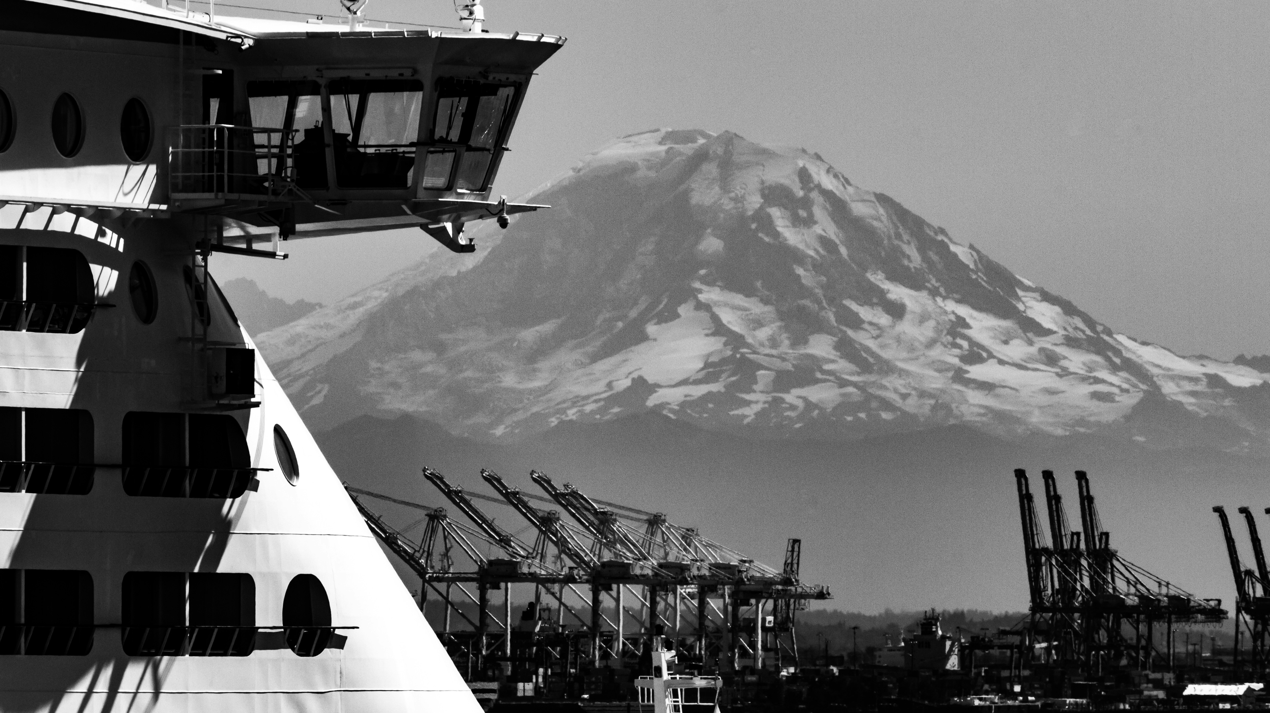
Thank You!

